Slide 1
Distributed coordination and synchronization:
Distributed mutex, distributed election, distributed consensus, distributed transaction, distributed locks
Distributed management and resources
Centralized structure, decentralized structure, scheduling
Distributed computation
MapReduce, Spark
Distributed communication
RPC, publish and subscribe, message queue
Distributed storage
CAP, distributed storage, distributed cache

Slide 2
CS 7172 Parallel and Distributed Computation Distributed Mutex and Election
Kun Suo
Computer Science, Kennesaw State University
https://kevinsuo.github.io/

Slide 3
What is Distributed Mutex?
Suppose you are making coffee at Starbucks, and someone takes away your cup, some other takes away the coffee machine
Ideal: you want to keep using the machine and cup without interference

Slide 4
What is Distributed Mutex?
Like the coffee machine, in distributed system, for the same shared resource, one program does not want to be disturbed by other programs while it is being used.
This requires that only one program can access this resource at a time

Slide 5
What is Distributed Mutex?
In a distributed system, the method to achieve access to exclusive resource is called Distributed Mutual Exclusion
The shared resource that is accessed by mutual exclusion is called Critical Resource

Slide 6
Method 1: Centralized algorithm
Add a "Coordinator" to restrict everyone to use self-service coffee machines in order to solve the problem of forcibly interrupting others

Slide 7
Method 1: Centralized algorithm
Centralized algorithm is also named as Central Server algorithm in distributed system
Coordinator
Currently using
Program 3
Program 1
Request queue
Program 2
Program 4
Program 3
Program 2
Program 4

Slide 8
Method 1: Centralized algorithm
Advantages:
Intuitive and simple
Less information interaction
Easy to implement
All programs need only communicate with the coordinator, no communication is required between programs

Slide 9
Method 1: Centralized algorithm
Disadvantages:
The coordinator will become the performance bottleneck of the system
If there are 100 programs accessing critical resources, the coordinator has to process 100 * 3 = 300 messages. The number of messages processed by the coordinator increases linearly with the number of programs that need to access critical resources
It is easy to cause a single point failure. Poor reliability.
The failure of the coordinator will make all programs lose access to critical resources and the entire system unavailable.

Slide 10
Method 2: Distributed algorithm
Do you use the coffee machine right now?
When you need to use a self-service coffee machine, you can ask other people first. When confirming that no other people are using, you can make your coffee.

Slide 11
Method 2: Distributed algorithm
How distributed algorithm works?
When a program wants to access a critical resource, it first sends a request message to other programs in the system.
After receiving the messages returned by all programs that no programs are using the resource, it can access the critical resource.
The request message includes the requested resource (which), the requester's ID (who), and the time the request was made (when).

Slide 12
Method 2: Distributed algorithm
Program 1
Resource A
A, 1, t₁
A, 1, t₁
Program 2
Program 3
Request queue in P2
A, 1, t₁
Request queue in P3
A, 1, t₁
Which, Who and When

Slide 13
Method 2: Distributed algorithm
Program 1
Resource A
A, 1, t₁
A, 1, t₁
Program 2
Program 3
When approved, the request queue is empty
Request queue in P2
Request queue in P3

Slide 14
Method 2: Distributed algorithm
Request queue in P1
A, 3, t₂
Program 1
A, 3, t₂
Resource A
A, 1, t₁
A, 1, t₁
Program 2
Program 3
A, 3, t₂
Request queue in P2
A, 3, t₂
Request queue in P3

Slide 15
Method 2: Distributed algorithm
Request queue in P1
A, 3, t₂
Program 1
A, 3, t₂
Resource A
A, 1, t₁
A, 1, t₁
Because program 2 does not use A, it returns yes immediately.
Program 2
Program 3
A, 3, t₂
Request queue in P2
Request queue in P3

Slide 16
Method 2: Distributed algorithm
When approved, the request queue is empty
Request queue in P1
When program 1 finishes using A, it will return yes to program 3.
Program 1
A, 3, t₂
A, 1, t₁
A, 1, t₁
Resource A
Program 2
Program 3
A, 3, t₂
Request queue in P2
Request queue in P3

Slide 17
Method 2: Distributed algorithm
Advantages:
Simple
Easy to implement

Slide 18
Method 2: Distributed algorithm
Disadvantages:
The number of messages will increase exponentially with the number of programs that need to access critical resources, leading to high "communication costs"
n programs accessing to critical resources will produce 2n(n-1) messages
Once a program fails and the confirmation message cannot be sent, other programs are in a state of waiting for a reply, making the entire system unusable

Slide 19


Method 3: Token Ring Algorithm
How token ring algorithm works?
All programs form a ring structure. Tokens are passed between programs in a clockwise (or counterclockwise) direction.
The program that receives the token has the right to access critical resources. After the access is completed, the token is transferred to the next program.
If the program does not need to access critical resources, just passes the token to the next program
1
Token
N
2
4
3

Slide 20
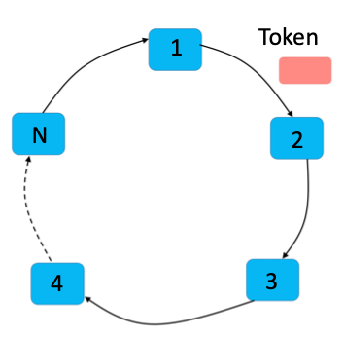
Scenario using Token Ring Algorithm
Walkie-talkie:
Can send or receive messages
Every time only one walkie-talkie can send
The walkie-talkie that holds the token can send and others just receive

Slide 21
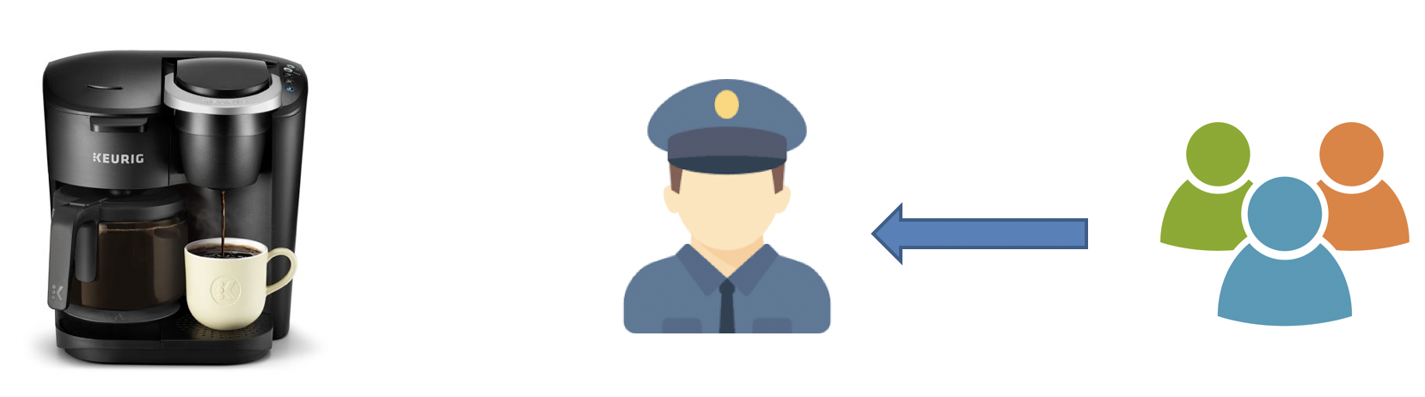
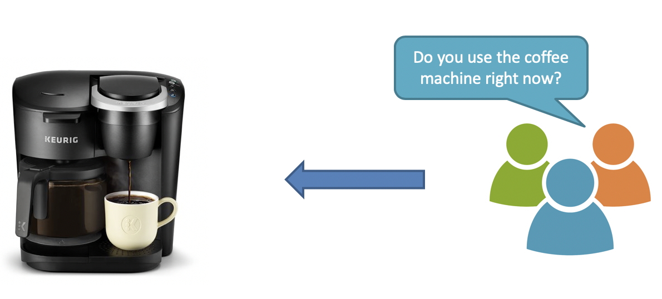
Distributed Mutex
Centralized algorithm
Distributed algorithm
Token Ring Algorithm

Slide 22
Why we need Distributed Election?
Master node is so important in distributed system
Scheduling and managing other nodes
What will happen when the master node crashed?

Slide 23
1. Bully algorithm
Nodes have two types: normal nodes and master nodes.
During initialization, all nodes are normal nodes, and have the right to become masters. However, after the election, only one node becomes the master node, and all other nodes are normal nodes. The node with the highest ID number from amongst the non-failed nodes is selected as the coordinator.
The master will be reelected if and only if the master node fails or loses connect with other nodes.

Slide 24
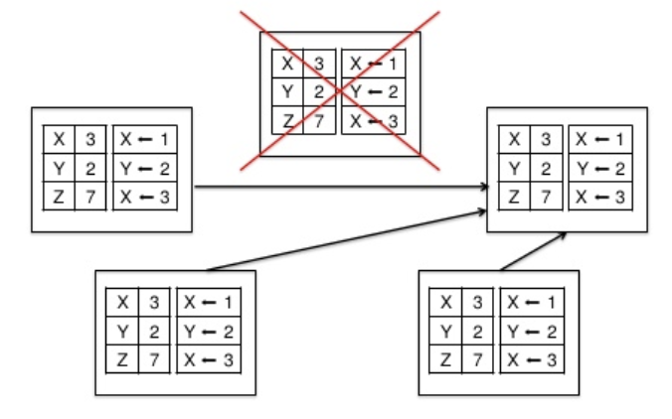
Bully algorithm example in MongoDB
How MongoDB deals with failure:
The node's last operation timestamp is used to represent the ID
The node with the latest timestamp has the largest ID, thus the live node with the latest timestamp is the master node
t0
t3
t2
t1

Slide 25
1. Bully algorithm
Advantages:
Fast election speed
low algorithm complexity
simple and easy to implement (who lives and who has the largest ID is the master node)

Slide 26
1. Bully algorithm
Disadvantages:
Each node needs to have global node information (all node IDs), so additional information needs to be stored → too much data
New election is required when any new node that is larger than the current master node ID → too many elections
Frequent switch over could happen when some nodes frequently join and exit the cluster → not stable

Slide 27
2. Raft algorithm
Similar as the democratic voting
The core idea is "the minority obeys the majority"
The node with the most votes becomes the master node

Slide 28
2. Raft algorithm
How Raft algorithm works:
1. Initialization, all nodes are in the Follower state.
start
Not received messages from leader for enough time
Follower
Next election
Leader is elected
heartbeat
Candidate
Leader
Received half votes

Slide 29
2. Raft algorithm
How Raft algorithm works:
2. At election, all nodes status change from Follower to Candidate, and send election requests to other nodes
start
Not received messages from leader for enough time
Follower
Next election
Leader is elected
heartbeat
Candidate
Leader
Received half votes

Slide 30
2. Raft algorithm
How Raft algorithm works:
3. When nodes receive election requests, the voting starts. Every election, one node can only vote once.
start
Not received messages from leader for enough time
Follower
Next election
Leader is elected
heartbeat
Candidate
Leader
Received half votes

Slide 31
2. Raft algorithm
How Raft algorithm works:
4. If the node that initiates the election request receives more than half of the votes, it will become the master node, and its status will be changed to Leader, and the status of other nodes will be reduced from Candidate to Follower.
Leader nodes and follower nodes send heartbeat packets periodically to detect whether the master node is alive.
start
Not received messages from leader for enough time
Follower
Next election
Leader is elected
heartbeat
Candidate
Leader
Received half votes

Slide 32
2. Raft algorithm
How Raft algorithm works:
5. When the term of the Leader node is reached, the status of the Leader node is changed from Leader to Follower, and a new round of election starts.
start
Not received messages from leader for enough time
Follower
Next election
Leader is elected
heartbeat
Candidate
Leader
Received half votes

Slide 33
2. Raft algorithm
When the new election starts in Raft algorithm:
When the leader term reaches
When the leader node fails or crashes
start
Not received messages from leader for enough time
Follower
Next election
Leader is elected
heartbeat
Candidate
Leader
Received half votes

Slide 34
Raft algorithm example in Kubernetes
How Kubernetes deals with data failure:
To ensure reliability, N nodes are usually deployed for data backup. One of the nodes will be selected as the master, and the other nodes will be used as backups.
Leader
Follower

Slide 35
2. Raft algorithm
Advantages:
Fast election speed
low algorithm complexity
simple and easy to implement (who lives and who has the half votes is the master node)

Slide 36
2. Raft algorithm
Disadvantages:
It requires that each node in the system can communicate with each other (vote), and requires the node which has more than half of the votes to be the master, thus the communication traffic is large

Slide 37
Comparison
 | Bully | Raft
How to elect leader | Largest ID | Get half of the votes
How the algorithm works | When nodes find no responses from leader or leader fails, raise new election | Every node can be Candidate and selected as Leader. Every follower can only vote once in every election.
Election time | Short | Long
Performance | Bully < Raft

